Slide 1
Home Rental Service App
Muneeb ur Rehman

Slide 2
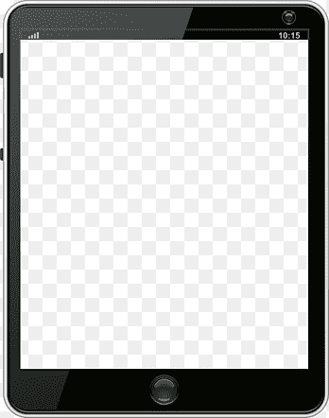
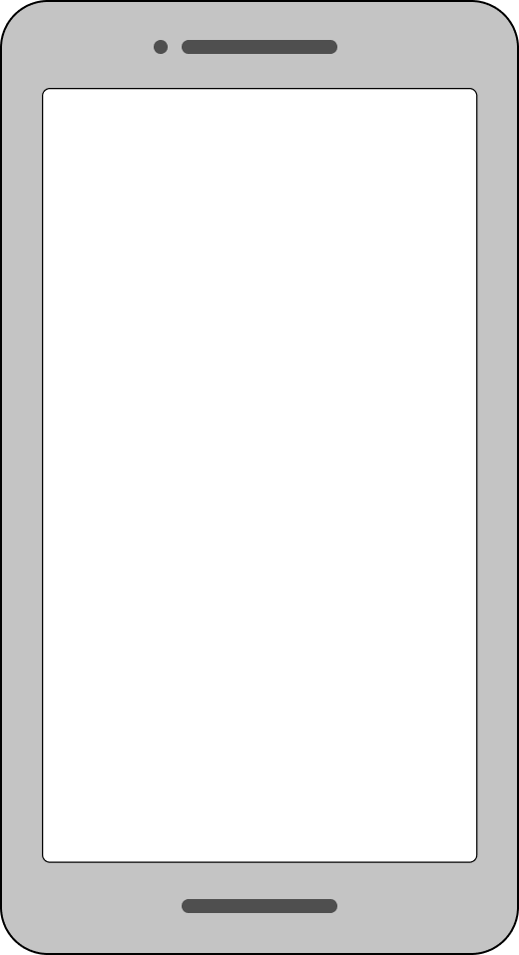
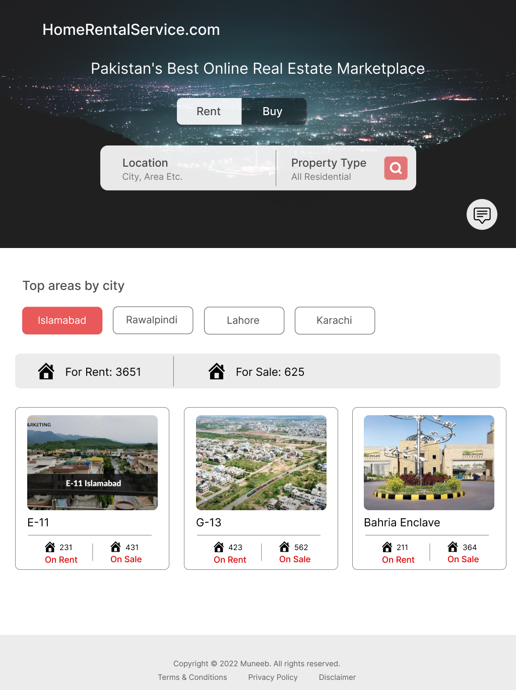
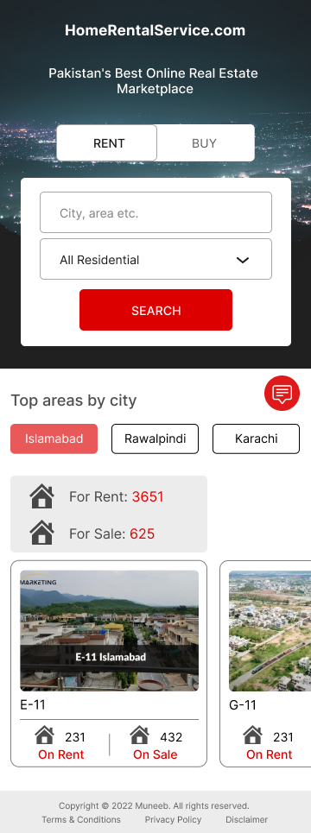
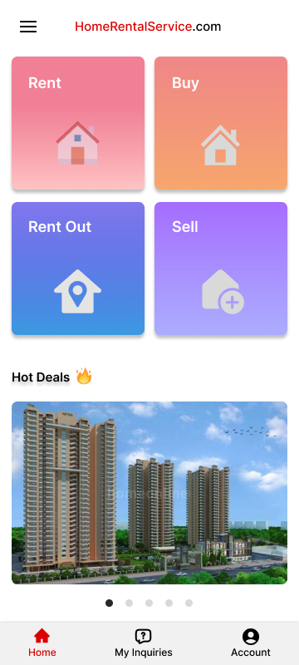
Project overview
The product:
It is a Home rental service app for those who want to find a rental home and also for property dealers, Who can insert their inventory into this app. This app is easy to use, and I design this app only for the social welfare of my society.
Project duration:
September to October 2022.

Slide 3
Project overview
The problem:
People are difficult to find a rental home during job hours because they have very limited time or students who move to a new city.
The goal:
My goal is to provide a Home service rental app to save time and easily find a rental house.

Slide 4
Project overview
My role:
UI/UX designer designing a Home rental service app for those who can’t find a rental home during office hours and the students from conception to delivery.
Responsibilities:
Conducting interviews, paper and digital wireframing, low and high-fidelity prototyping, conducting usability studies, accounting for accessibility, and iterating on designs.

Slide 5
User research
Personas
Problem statements
User journey maps
Understanding
the user

Slide 6
User research: summary
I conducted interviews and created empathy maps to understand the users, I was
designing for and their needs. A primary user group identified through research that they had difficulty finding a rental home during job hours because they have limited time, and also difficult for those students who come to a new city for their studies.

Slide 7
User research: pain points
1
2
3
Time
Approachability
Familiarity
There is very difficult to find the rental home because people have very limited time.
There are a lot of people who want to move to another country or city but they can’t find a rental home before reaching there.
There are a lot of people or students who come to a new city but they are not familiar with the areas or people to find a rental home.

Slide 8
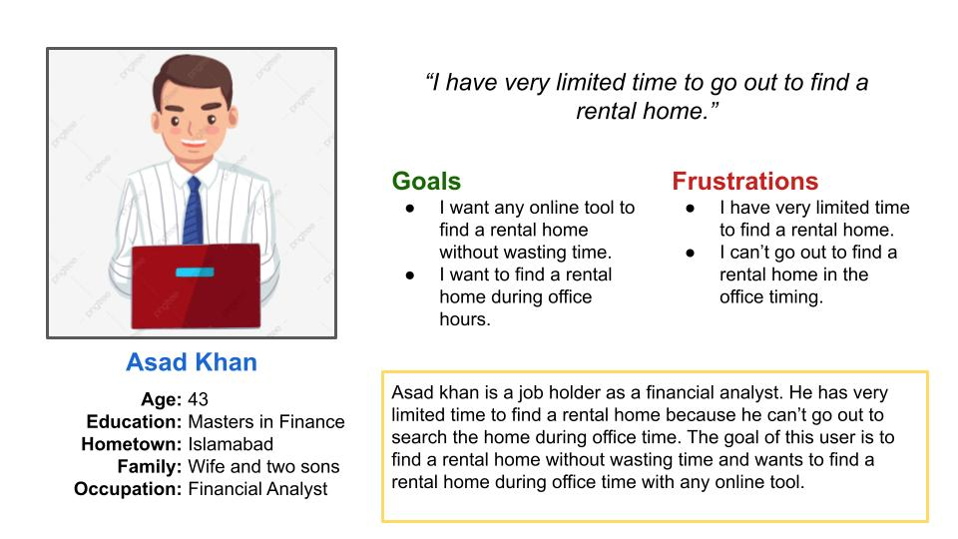
Persona: Asad Khan
Problem statement:
Asad khan is a job holder as a financial analyst who needs to find a rental home during office hours because he is busy during office hours.

Slide 9
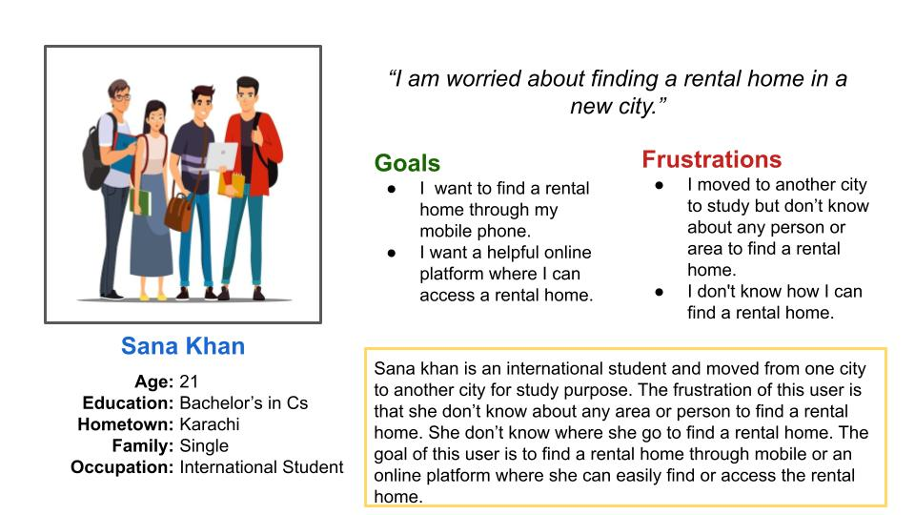
Persona: Sana Khan
Problem statement:
Sana khan is a student who needs to find a rental home in a new city because she is not familiar with the people and area.

Slide 10
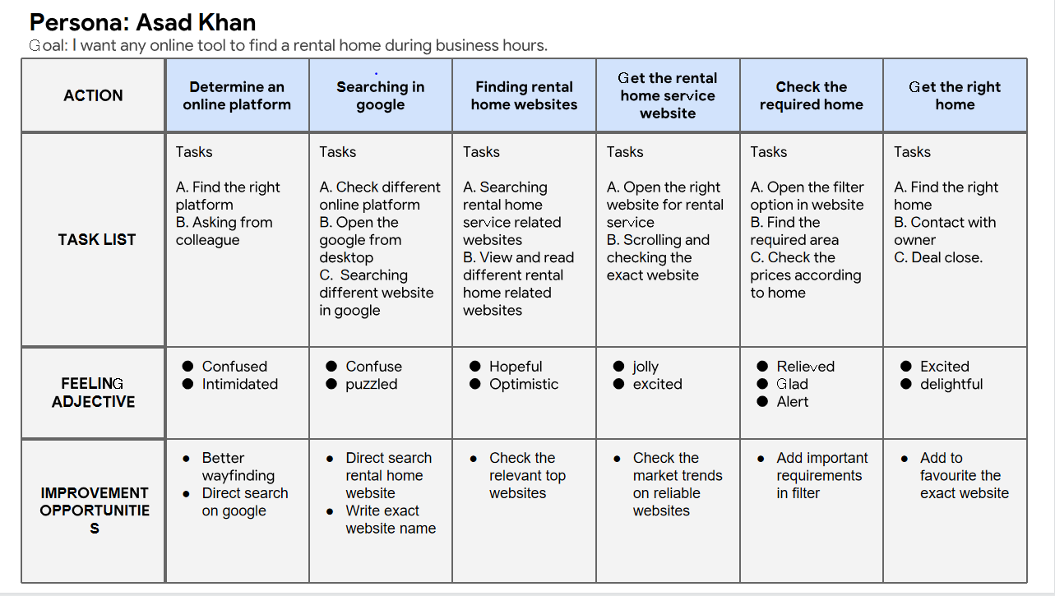
User journey map
Mapping Asad khan user journey revealed how helpful it would be for users to have access to a dedicated home rental service app.

Slide 11
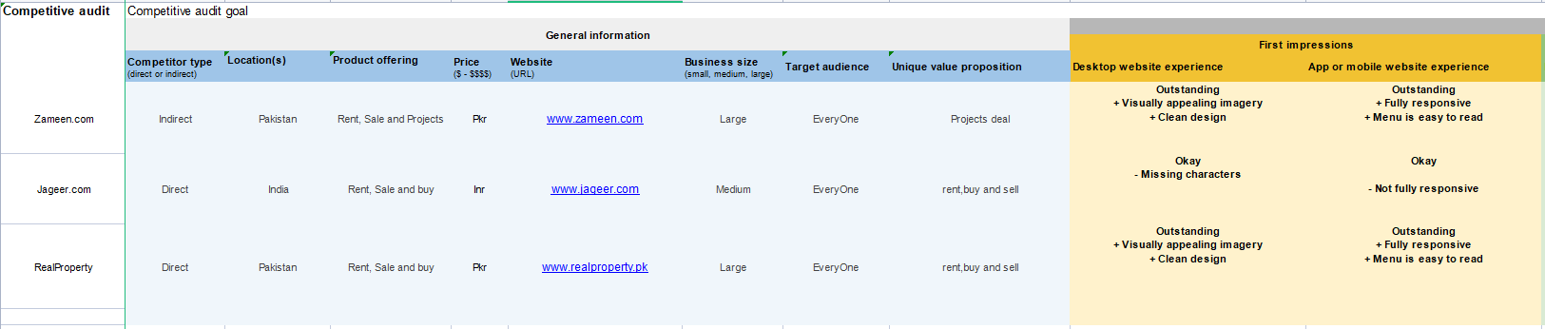
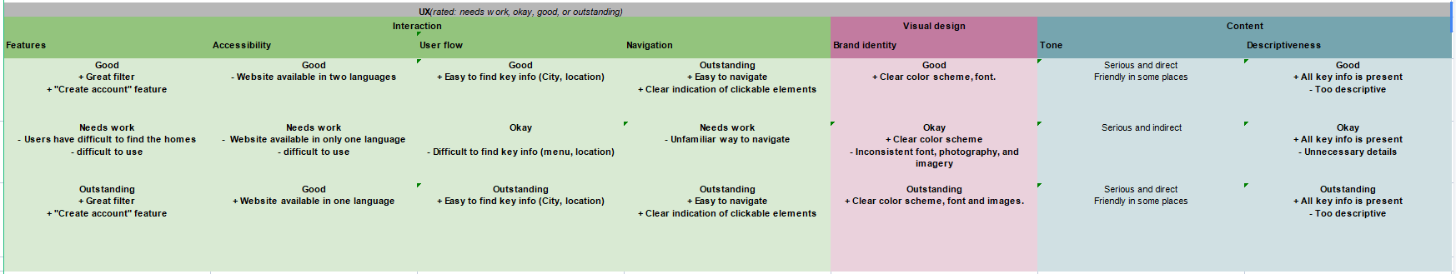
Competitive Audit
An audit of a few competitor’s products provided direction on gaps and opportunities to adress with the home rental service app.
Click to view the full Competitive Audit

Slide 12
Paper wireframes
Digital wireframes
Low-fidelity prototype
Usability studies
Starting
the design

Slide 13
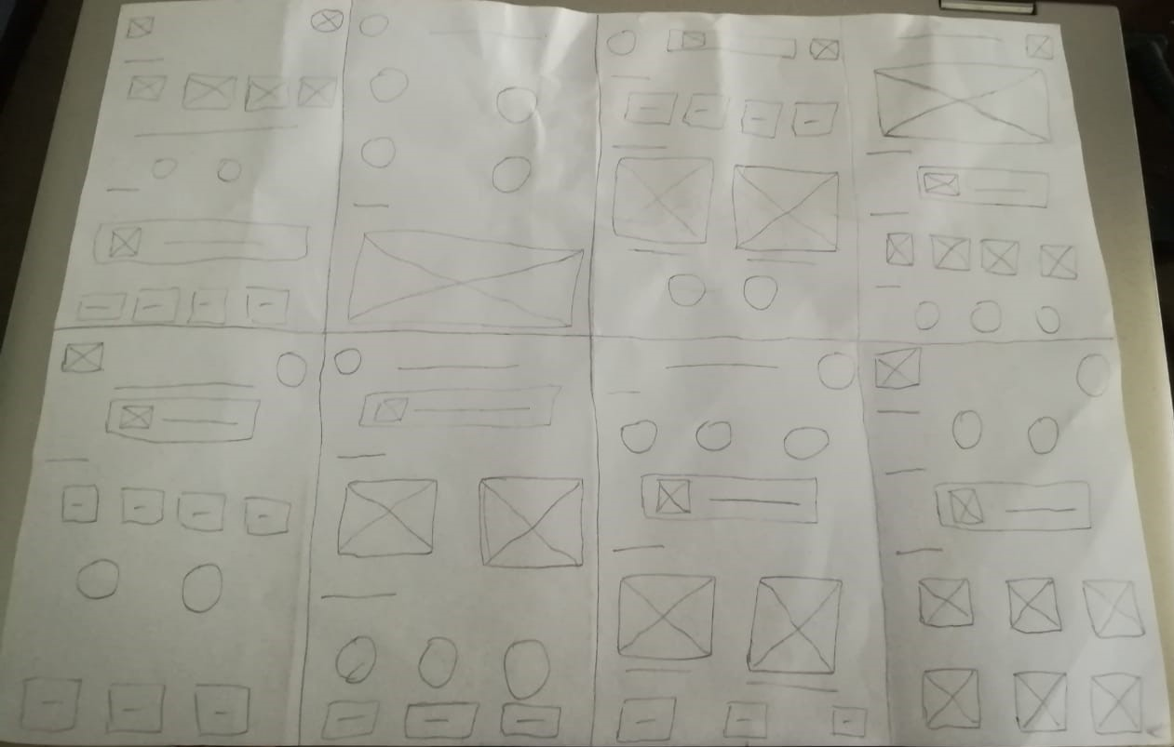
Paper wireframes
Taking the time to draft iterations of each screen of the app on paper ensured that the elements that made it to digital wireframes would be well-suited to address user pain points. For the home screen, I prioritized a quick and easy online searching process to help users save time.

Slide 14
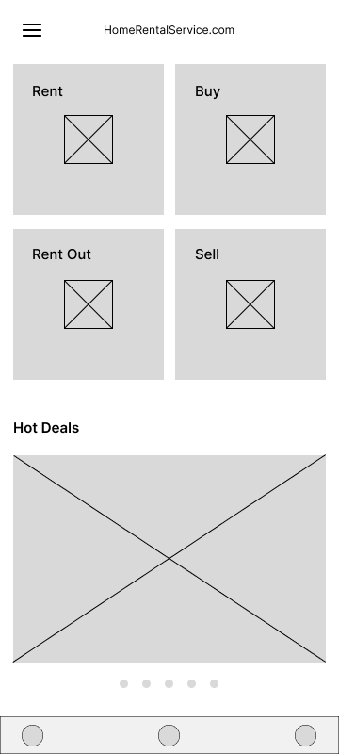
Digital wireframes
This button at the top left of the home screen shows the all avilable rent houses, flats, appartments etc.
As the initial design phase continued, I made sure to base screen designs on feedback and findings from the user research.
This image shows the latest projects for sale.

Slide 15
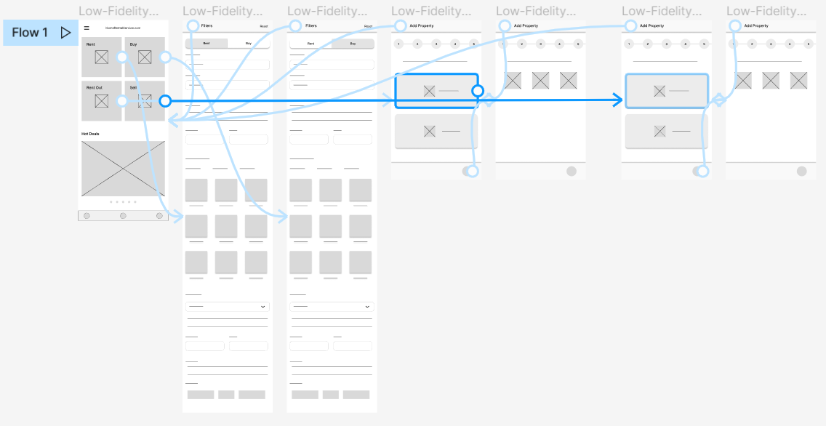
Low-fidelity prototype
Using the completed set of digital wireframes, I created a low-fidelity prototype. The primary user flow I connected was complete detail of rental houses according to area selection, So the prototype could be used in a usability study.
View Home Rental App
Low Fidelity Prototype

Slide 16
Usability study: findings
I conducted two rounds of usability studies. Findings from the first study helped guide the designs from wireframes to mockups. The second study used a high-fidelity prototype and revealed what aspects of the mockups needed refining.
Round 1 findings
Round 2 findings
1
User need more intuitive way to find the specific location or area selection
1
Users want more customization options
2
users need custom format in price range
2
Users need a notifications on 100 views per add

Slide 17
Refining
the design
Mockups
High-fidelity prototype
Accessibility

Slide 18
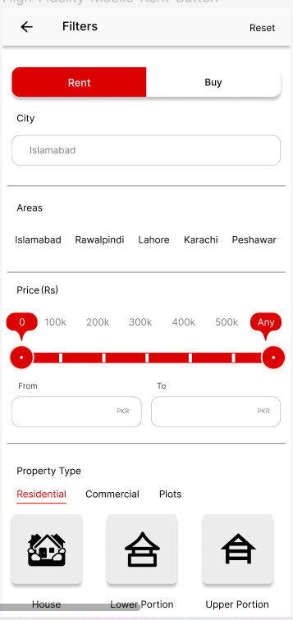
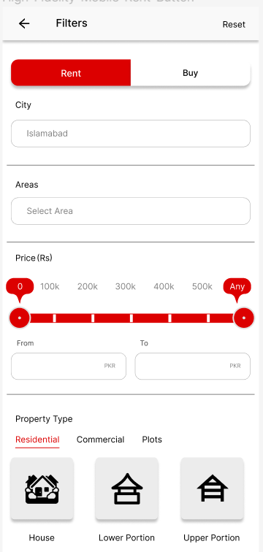
Mockups
Before usability study
After usability study
Based on the insight from the usability studies, I applied design changes like providing area selection in which all areas are mentioned, User’s can choose his/her own choice area.

Slide 19
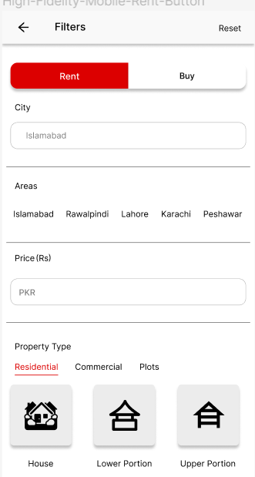
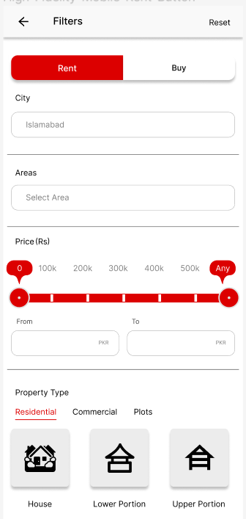
Mockups
Before usability study
After usability study
Aditional design changes included adding an option of price range, Now the user’s can easily add his price range to find a rental home.

Slide 20
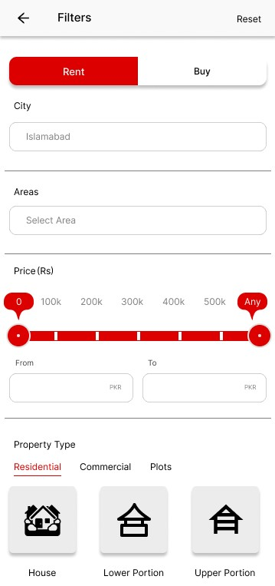
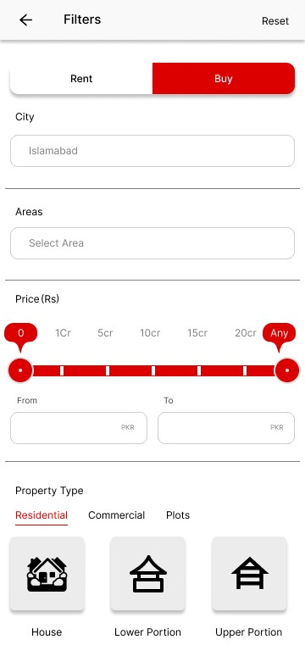
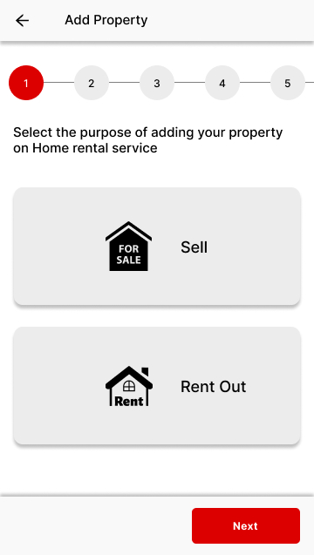
Mockups

Slide 21
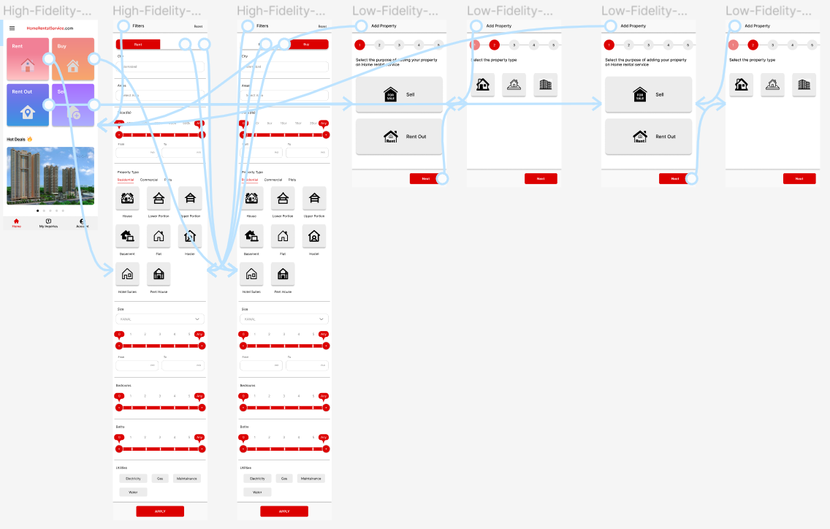
High-fidelity prototype
The final high-fidelity prototype presented cleaner user flows for searching rental home process. It also met user needs to add price range as well as more customization.
View Home Rental App
High Fidelity Prototype

Slide 22
Accessibility considerations
1
2
3
Provided access
to users who are vision impaired through adding alt text to images for screen readers.
Used icons to
help make
navigation easier
Used clear indications for every step to use or find specific property type

Slide 23
Responsive Design
Information Architecture
Responsive Design

Slide 24
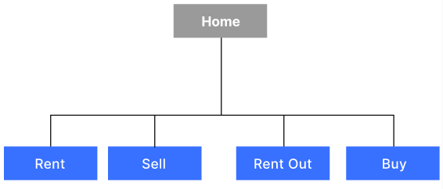
Sitemap
With the app designs completed, I started work on designing the responsive website. I used the home rental service sitemap to guide the organizational structure of each screen’s design to ensure a cohesive and consistent experience across device.

Slide 25
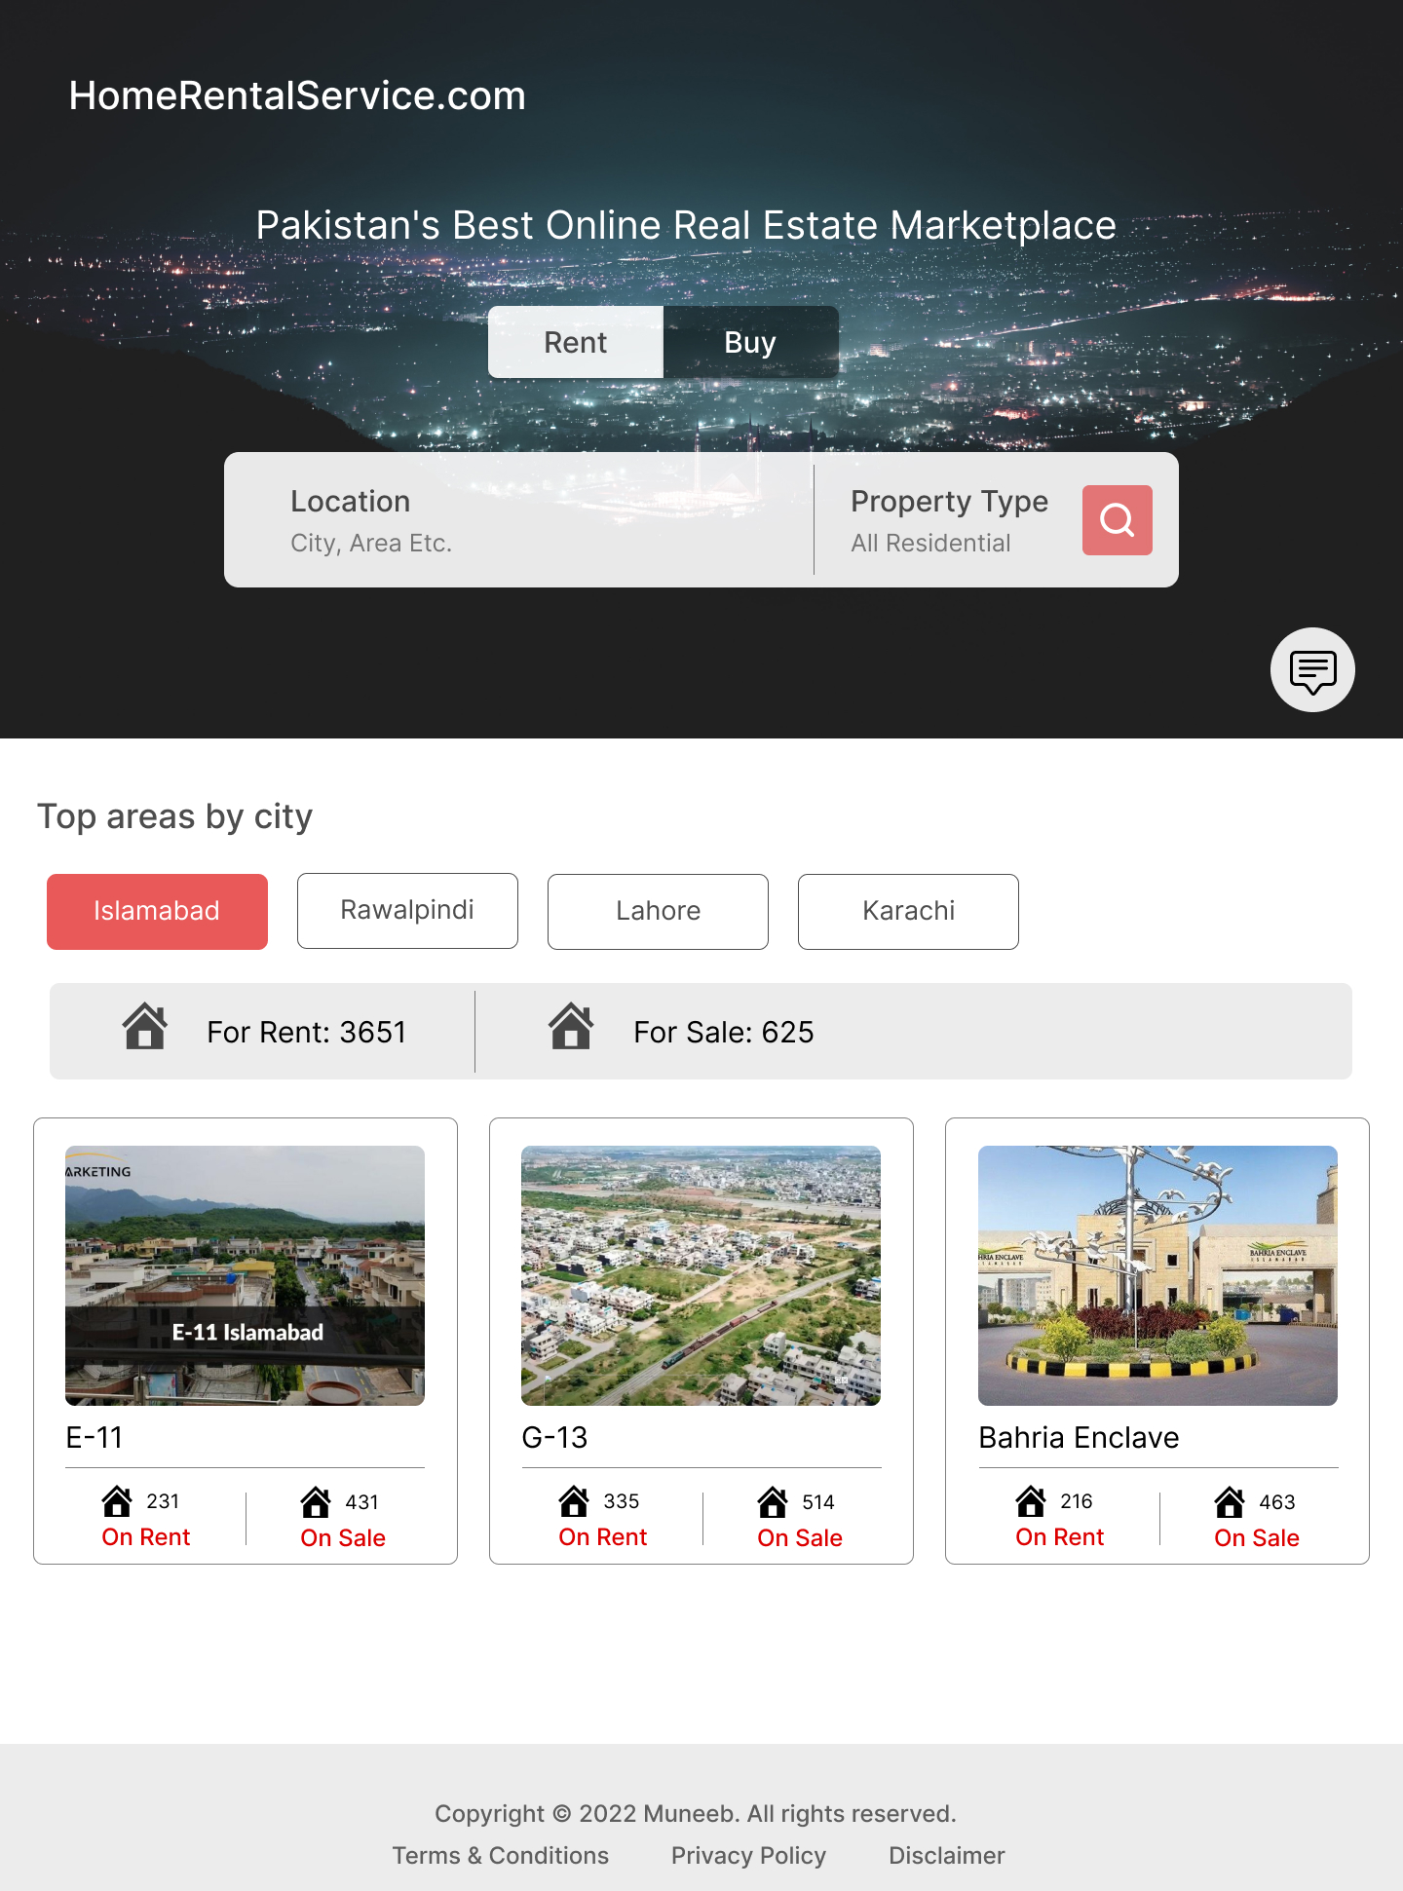
Responsive Design
Mobile Website
Tablet
Desktop
The designs for screen size variation included mobile, tablet and desktop. I optimized the designs to fit specific user needs of each device and screen size.

Slide 26
Going forward
Takeaways
Next steps

Slide 27
Takeaways
Impact:
The app makes users feel like Rental home service app really thinks about how to meet their needs.
One quote from peer feedback:
“The app made it so easy and useful to complete the finding a rental home. I would definitely use this app to find the rental home very easy”.
What I learned:
While designing the Rental home service app, I learned that the first ideas for the app are only the beginning of the process. Usability studies and peer feedback influenced each iteration of the app’s designs.

Slide 28
Next steps
1
2
Conduct another round of usability studies to validate whether the pain points users experienced have been effectively addressed.
Conduct more user research to determine any new areas of need.

Slide 29
Insert a few sentences summarizing the next steps you would take with this project and why. Feel free to organize next steps in a bullet point list.
Let’s connect!
Thank you for your time reviewing my work on the Rental home service app! If you’d like to
see more or get in touch, my contact information is provided below.
Email: muneeb.ur.rehman36316@gmail.com
Contact: +92 334-5036316

Slide 30
Thank you!

